Slide 1

Veeam Availability Suite v10 소개 자료
Veeam Software Korea
Sales.Korea@veeam.com, 2020.10

Slide 2
NAS 데이터 보호
Notes:
#MASTER DECK INFO: <Information about this slide>
#VERSION: 2019/08/09
#EDITS: Changed Icon

Slide 3

향상된
NAS Backup

Slide 4




NAS 과제
빠른 증가
지속적으로 늘어나는 파일 개수
파일 크기의 증가 (영상, 이미지, 등)
더 오래
유지
비정형 데이터가
제한없이 증가
Notes:
Today’s NAS challenges come in many forms:
Sheer growth – the number of objects in storage being driven by unstructured data growth
With this unstructured data, much of the files are rich (video, graphics, etc) and are large in size
Businesses are keeping data longer for reasons beyond just recovery, including regulations and compliance
As unstructured data is generated by users and devices every moment of the day with limited to no oversight, the growth goes unchecked

Slide 5
Veeam Availability Suite v10의 제공…
Veeam® Availability Suite™ v10 는 다음과 같은 NDMP에 대한 제한을 극복:
모든 백업에 대해 Full 백업 필요
백업과 복구 위치에 대한 제약
강력해진 NAS Backup
방대한 파일 데이터를 가진 NAS에 대한 새로운 데이터 보호 방안
Notes:
VAS v10 helps customers to overcome the historic limitations of NDMP by extending powerful change file tracking making the backup of unstructured data on NAS fast with very flexible recovery.

Slide 6




향상된 NAS Backup
유연성
변경 파일 추적
Snapshot 친화적
SMB v1, 2, 3
NAS
Folder 1
Folder 3
File A
Folder2
File B
File C
File D
No File Locks
NFS v3, 4.1
Point in Time
Windows File Server
낮은 서비스 영향
Linux File Server
복구 옵션: 전체 파일, 특정 시점(Point in Time), 파일 레벨 복구
Notes:
Flexible
There are many types of NAS Systems with many protocols and versions being used across the world to present their unstructured data, with the new enhanced NAS Back up we have the ability to protect SMB NFS but also Windows fileservers and Linux fileservers The unique Veeam change file tracking engine ensures fast incremental backups take place, that only the changes since the last backup are captured but in doing so understanding what has changed since the last backup in an extremely fast and efficient way. With the ability to scale up and down, Veeam file proxies can be added or removed to achieve the desired performance for NAS backup . Snapshot friendly is the ability for Veeam to leverage storage snapshots where possible as the source of the backup. Thus removing the hindrance of locked files and also any impact on production performance.

Slide 7
NAS Backup - v10

Slide 8
NAS Backup
Veeam만의 장점
높은 확장성
광범위한 백업 대상
효율적인 영구 증분 백업
NAS 스토리지와 무관한 변경 파일 추적
Storage Snapshot 지원
단순한 오프 사이트 백업
오브젝트 스토리지와의 통합

Slide 9
Enhanced NAS Backup
유연성
변경 파일 추적
Snapshot 친화적
SMB v1, 2, 3
NAS
Folder 1
Folder 3
File A
Folder2
File B
File C
File D
No File Locks
NFS v3, 4.1
Point in Time
Windows File Server
낮은 서비스 영향
Linux File Server
복구 옵션: 전체 파일, 특정 시점(Point in Time), 파일 레벨 복구
Notes:
#MASTER DECK INFO: <Information about this slide>
#VERSION: 2020/02/20
#EDITS: <What’s changed>
- Note: copied from Velocity EMEA deck
Flexible
There are many types of NAS Systems with many protocols and versions being used across the world to present their unstructured data, with the new enhanced NAS Back up we have the ability to protect SMB NFS but also Windows fileservers and Linux fileservers The unique Veeam change file tracking engine ensures fast incremental backups take place, that only the changes since the last backup are captured but in doing so understanding what has changed since the last backup in an extremely fast and efficient way. With the ability to scale up and down, Veeam file proxies can be added or removed to achieve the desired performance for NAS backup . Snapshot friendly is the ability for Veeam to leverage storage snapshots where possible as the source of the backup. Thus removing the hindrance of locked files and also any impact on production performance.

Slide 10



NAS Backup
단순함
유연성
신뢰성
단순한 구성
마법사 기반의 화면
소프트웨어 기반
낮은 서비스 영향도
확장가능한 솔루션
광범위한 백업 대상 지원
스토리지와 무관한 변경 파일 추적
파일단위 복구
빠른 변경 백업
단기 & 장기 보관
스토리지 Snapshot 지원
Notes:
#MASTER DECK INFO: <Information about this slide>
#VERSION: 2020/02/20
#EDITS: <What’s changed>

Slide 11
NAS Backup
Veeam만의 장점
높은 확장성
광범위한 백업 대상
효율적인 영구 증분 백업
NAS 스토리지와 무관한 변경 파일 추적
Storage Snapshot 지원
단순한 오프 사이트 백업
오브젝트 스토리지와의 통합

Slide 12






NAS Backup - 아키텍쳐
Cache
Repository
Secondary Repository
DAS
File Proxy
Backup Repository
Archive Repository
NAS
File Share
Notes:
#MASTER DECK INFO: NAS Backup - Components
#VERSION: 2020/02/20 – Taran Cunningham
#EDITS: <What’s changed>
Components involved in NAS backup

Slide 13
File Share
DAS (Direct Attached Storage)
Windows Server
Linux Server
NAS (Network Attached Storage)
SMB v1, v2 or v3
NFS v3 or v4.1
Storage Snapshot 지원
잠긴 파일에 대한 백업
Cache
Repository
Secondary Repository
DAS
File Proxy
Backup Repository
Archive Repository
NAS
File Share
Notes:
#MASTER DECK INFO: NAS Backup – Components - File Share
#VERSION: 2020/02/20 – Taran Cunningham
#EDITS: <What’s changed>
Information about the file share

Slide 14
File Proxy
Windows system
File share를 통한 파일 처리
Path
Direct (SMB/NFS)
Snapshot 경로 (storage와의 통합)
VSS snapshot
Cache
Repository
Secondary Repository
DAS
Backup
Job
File Proxy
Backup Repository
Archive Repository
NAS
File Share
Notes:
#MASTER DECK INFO: <Information about this slide>
#VERSION: 2020/02/20
#EDITS: <What’s changed>

Slide 15
Cache Repository
증분 백업 시 스토리지 로드를 줄이기 위해 메타 데이터 (finger print)를 포함
독립형 Repository - Windows, Linux 또는 공유 폴더
SOBR(Scale-Out Backup repository),중복제거 장치, REFS 제외
Cache
Repository
Finger
Prints
Secondary Repository
DAS
File Proxy
Backup Repository
Archive Repository
NAS
File Share
Notes:
#MASTER DECK INFO: <Information about this slide>
#VERSION: 2020/02/20
#EDITS: <What’s changed>

Slide 16
Backup Repository
일반적인 VBR repository
SOBR(Scale-Out Backup Repository) 지원, Capacity Tier 는 무시
Tape 제외
단기 보관 스토리지
최신 백업본을 저장
Cache
Repository
Secondary Repository
DAS
Backup
Job
Backup
Job
File Proxy
Backup Repository
Archive Repository
NAS
File Share
Notes:
#MASTER DECK INFO: <Information about this slide>
#VERSION: 2020/02/20
#EDITS: <What’s changed>

Slide 17
Archive Repository
장기 보관 스토리지
아카이브 대상을 포함하거나 제외 가능
비용 효율적인 2차 스토리지
독립형
오브젝트 스토리지
Tape 제외
Cache
Repository
Secondary Repository
DAS
Archives
File Proxy
Backup Repository
Archive Repository
NAS
File Share
Notes:
#MASTER DECK INFO: <Information about this slide>
#VERSION: 2020/02/20
#EDITS: <What’s changed>

Slide 18
2차 Repository
백업 Repository의 2차 백업본 (단기 보관)
Backup Copy Job으로 저장
일반적인 VBR repository
SOBR(Scale-Out Backup Repository) 지원, Capacity Tier 는 무시
Tape 제외
Cache
Repository
Backup
Copy Job
Secondary Repository
DAS
File Proxy
Backup Repository
Archive Repository
NAS
File Share
Notes:
#MASTER DECK INFO: <Information about this slide>
#VERSION: 2020/02/20
#EDITS: <What’s changed>

Slide 19
File Share의 보호 방법

Slide 20
File Share Backup Jobs
File Proxy 할당
File Proxy
File Share
Notes:
#MASTER DECK INFO: <Information about this slide>
#VERSION: 2020/02/20
#EDITS: <What’s changed>
From: https://helpcenter.veeam.com/docs/backup/vsphere/how_file_share_backup_works.html?ver=100
How File Share Backup Works
Veeam Backup & Replication performs file share backup in the following way:
When a new backup job session starts, Veeam Backup & Replication assigns a file proxy. The File Proxy is the main worker, it will enumerate files and folders on the file share and to create a file tree. It will also do the backup activities.

Slide 21


File Share Backup Jobs
File Proxy 할당
File Proxy 는 File Share 의 파일 및 폴더를 열거하고 cyclic redundancy check (CRC) 값으로 File tree를 생성
File
Share
Folder 1
Folder 2
Folder 3
File A
File B
File Proxy
File Share
File C
File D
File Tree
Notes:
#MASTER DECK INFO: <Information about this slide>
#VERSION: 2020/02/20
#EDITS: <What’s changed>
From: https://helpcenter.veeam.com/docs/backup/vsphere/how_file_share_backup_works.html?ver=100
2. The file proxy enumerates files and folders on the file share and creates the file tree with cyclic redundancy check (CRC) values.

Slide 22
File Share Backup Jobs
File Proxy 할당
File Proxy 는 File Share 의 파일 및 폴더를 열거하고 cyclic redundancy check (CRC) 값으로 File Tree를 생성
File Proxy 가 File Tree를 Cache Repository 로 전송
File
Share
Cache
Repository
Folder 1
Folder 2
Folder 3
File A
File B
File Proxy
File Share
File C
File D
File Tree
Notes:
#MASTER DECK INFO: <Information about this slide>
#VERSION: 2020/02/20
#EDITS: <What’s changed>
From: https://helpcenter.veeam.com/docs/backup/vsphere/how_file_share_backup_works.html?ver=100
3. The file proxy transfers the file tree to the cache repository.

Slide 23
File Share Backup Jobs
File Proxy 할당
File Proxy 는 File Share 의 파일 및 폴더를 열거하고 cyclic redundancy check (CRC) 값으로 File Tree를 생성
File Proxy 가 File Tree를 Cache Repository 로 전송
Cache Repository 가 File Tree를 저장
File
Share
Cache
Repository
Folder 1
Folder 2
Folder 3
File A
File B
File C
File D
File Tree
File Proxy
File Share
Notes:
#MASTER DECK INFO: <Information about this slide>
#VERSION: 2020/02/20
#EDITS: <What’s changed>
From: https://helpcenter.veeam.com/docs/backup/vsphere/how_file_share_backup_works.html?ver=100
4. The cache repository saves the file tree.

Slide 24

File Share Backup Jobs
File Proxy 할당
File Proxy 는 File Share 의 파일 및 폴더를 열거하고 cyclic redundancy check (CRC) 값으로 File Tree를 생성
File Proxy 가 File Tree를 Cache Repository 로 전송
Cache Repository 가 File Tree를 저장
Cache Repository 는 새로운 File Tree를 이전 버전과 비교하여 File Proxy 로 백업 할 대상 파악
Cache
Repository
File
Share
File Share
Folder 1
Folder 3
File D
Folder 1
Folder 2
Folder 3
File A
File B
File Proxy
File Share
File C
File D
Notes:
#MASTER DECK INFO: <Information about this slide>
#VERSION: 2020/02/20
#EDITS: <What’s changed>
From: https://helpcenter.veeam.com/docs/backup/vsphere/how_file_share_backup_works.html?ver=100
5. When the cache repository receives a new tree structure from the proxy, it compares it with the file tree created during the previous run of the backup session. If any files or folders of the file share have changed since the previous backup session run, the cache repository instructs the file proxy to start reading changed data from the source file share.

Slide 25


File Share Backup Jobs
File Proxy 할당
File Proxy 는 File Share 의 파일 및 폴더를 열거하고 cyclic redundancy check (CRC) 값으로 File Tree를 생성
File Proxy 가 File Tree를 Cache Repository 로 전송
Cache Repository 가 File Tree를 저장
Cache Repository 는 새로운 File Tree를 이전 버전과 비교하여 File Proxy 로 백업 할 대상 파악
File Proxy 는 File Share 에서 필요한 데이터를 읽고
File Share
Folder 1
Folder 3
File D
File Proxy
File Share
Notes:
#MASTER DECK INFO: <Information about this slide>
#VERSION: 2020/02/20
#EDITS: <What’s changed>
From: https://helpcenter.veeam.com/docs/backup/vsphere/how_file_share_backup_works.html?ver=100
6. The file proxy reads new data from the file share.

Slide 26
File Share Backup Jobs
File Proxy 할당
File Proxy 는 File Share 의 파일 및 폴더를 열거하고 cyclic redundancy check (CRC) 값으로 File Tree를 생성
File Proxy 가 File Tree를 Cache Repository 로 전송
Cache Repository 가 File Tree를 저장
Cache Repository 는 새로운 File Tree를 이전 버전과 비교하여 File Proxy 로 백업 할 대상 파악
File Proxy 는 File Share 에서 필요한 데이터를 읽고
File Proxy 는 새로운 백업본을 생성
M
File Proxy
File Share
Notes:
#MASTER DECK INFO: <Information about this slide>
#VERSION: 2020/02/20
#EDITS: <What’s changed>
From: https://helpcenter.veeam.com/docs/backup/vsphere/how_file_share_backup_works.html?ver=100
7. The file proxy creates data packages. Data packages contain backup data saved as data files (each 64 Mb in size) and metadata files that contain names and versions of backup files and allocation of data in backup files.

Slide 27
File Share Backup Jobs
File Proxy 할당
File Proxy 는 File Share 의 파일 및 폴더를 열거하고 cyclic redundancy check (CRC) 값으로 File Tree를 생성
File Proxy 가 File Tree를 Cache Repository 로 전송
Cache Repository 가 File Tree를 저장
Cache Repository 는 새로운 File Tree를 이전 버전과 비교하여 File Proxy 로 백업 할 대상 파악
File Proxy 는 File Share 에서 필요한 데이터를 읽고
File Proxy 는 새로운 백업본을 생성
File Proxy 가 새로운 백업본을 Backup Repository 로 전송
M
File Proxy
Backup Repository
File Share
Notes:
#MASTER DECK INFO: <Information about this slide>
#VERSION: 2020/02/20
#EDITS: <What’s changed>
From: https://helpcenter.veeam.com/docs/backup/vsphere/how_file_share_backup_works.html?ver=100
8. The file proxy sends new data to the target backup repository.

Slide 28
File Share Backup Jobs
File Proxy 할당
File Proxy 는 File Share 의 파일 및 폴더를 열거하고 cyclic redundancy check (CRC) 값으로 File Tree를 생성
File Proxy 가 File Tree를 Cache Repository 로 전송
Cache Repository 가 File Tree를 저장
Cache Repository 는 새로운 File Tree를 이전 버전과 비교하여 File Proxy 로 백업 할 대상 파악
File Proxy 는 File Share 에서 필요한 데이터를 읽고
File Proxy 는 새로운 백업본을 생성
File Proxy 가 새로운 백업본을 Backup Repository 로 전송
필요 시 Archive Repository 의 업데이트
Archive Data
File Proxy
Backup Repository
Archive Repository
File Share
Notes:
#MASTER DECK INFO: <Information about this slide>
#VERSION: 2020/02/20
#EDITS: <What’s changed>
From: https://helpcenter.veeam.com/docs/backup/vsphere/file_share_backup_job_storage.html?ver=100
9. By default, all files deleted from the short-term backup repository will be moved to the long-term archive repository. If you do not need all the files in the long-term archive, you can choose what files to keep.
Under Limit number of file versions to keep, specify how many file versions must be archived:
Active file versions to keep — select this check box to archive files currently existing in the source file share. Specify how many recent versions of active files copied from the short-term repository must be stored in the long-term repository.
Deleted file versions to keep — select this check box to archive files deleted from the source file share. Specify how many latest versions of deleted files copied from the short-term repository must be stored in the long-term repository.
Under Files to archive, specify what files must be archived:
All files — select this option to archive all files deleted from the short-term repository.
All files except the following extensions — select this option to exclude files with certain extensions from the selection to be archived. Specify extensions for files to exclude from the selection. Files with the specified extensions will not be copied to the long-term repository.
Files with the following extensions only — select this option to archive files with certain extensions only. Specify extensions for files to archive. Files with these extensions will be copied to the long-term repository from the short-term storage.

Slide 29




Incremental Backup
Changed File Tracking
Changed Files & Folders
NAS
Folder 1
Folder 3
File D
NAS
Folder 1
Folder 3
File A
Folder 2
File B
File C
File D
.vcache
Cache
Repository
File Proxy
Backup Repository
Notes:
The cache repository saves the tree structure for files and folders of the file share.
During a Backup Job, the
When the proxy receives a new tree structure from the cache repository, it compares the new tree structure with the one created for the previous restore point and stored at the cache repository. If any files or folders in the file share have changed since the previous backup run, the cache repository instructs the backup repository to schedule resources and to the file proxy to start reading this data from the source file share.
The file proxy reads new data from the file share.
The file proxy creates data packages.
The file proxy sends new data to the backup repository.

Slide 30
Checksums
Checksum을 비교하여 폴더가 변경되었는지 확인
하위 폴더에 대한 반복 수행
변경 사항이 없는 폴더는 무시
Notes:
#MASTER DECK INFO: <Information about this slide>
#VERSION: 2019/07/31
#EDITS: <What’s changed>
When a new backup job session starts, Veeam Backup & Replication assigns a file proxy to enumerate files and folders on the file share and to create a file tree with cyclic redundancy check (CRC) values.
The file proxy enumerates files and folders on the file share and creates the file tree with CRC values.
The file proxy transfers the file tree to the cache repository.
The cache repository saves the file tree
When the cache repository receives a new tree structure from the proxy, it compares it with the file tree created during the previous run of the backup session. If any files or folders of the file share have changed since the previous backup session run, the cache repository instructs the file proxy to start reading changed data from the source file share.
The file proxy reads new data from the file share.
The file proxy creates data packages. Data packages contain backup data saved as data files (each 64 Mb in size) and metadata files that contain names and versions of backup files and allocation of data in backup files.
The file proxy sends new data to the target backup repository.

Slide 31
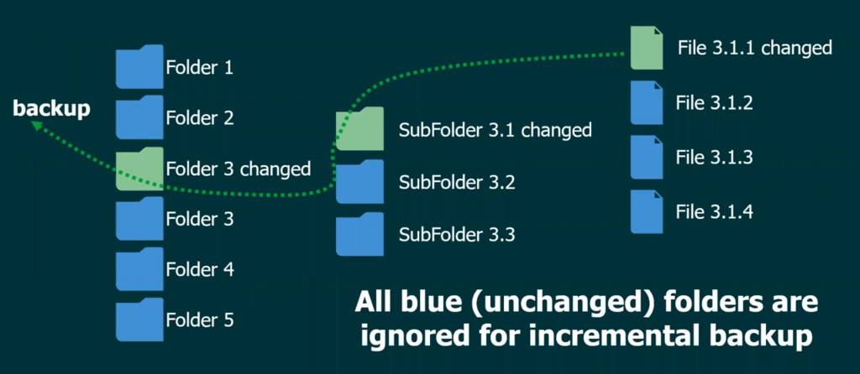
NAS Backup
Incremental Backup Example
Notes:
When Veeam Backup & Replication executes a new file share backup session, it performs the following operations:
Veeam Backup & Replication instructs the file proxy to enumerate folders on the file share and to build a tree structure of files and folders.
The file proxy enumerates files and folders on the file share and builds the tree structure for them.
The file proxy transfers this tree structure to the cache repository.
The cache repository saves the tree structure for files and folders of the file share. When the proxy receives a new tree structure from the cache repository, it compares the new tree structure with the one created for the previous restore point and stored at the cache repository. If any files or folders in the file share have changed since the previous backup run, the cache repository instructs the backup repository to schedule resources and to the file proxy to start reading this data from the source file share.
The file proxy reads new data from the file share.
The file proxy creates data packages.
The file proxy sends new data to the backup repository.

Slide 32


Locked Files
Without Snapshots
Job 실행이 끝나면 잠긴 파일을 다시 시도
Storage Snapshot에서 잠긴 파일 백업
NFS 및 SMB File Share에서 가능
Storage snapshot은 자동으로 생성되지 않음
Pre-job script를 통해 Storage Snapshot 생성
Microsoft VSS Snapshot에서 잠긴 파일 백업
SMB 3.0 이상에서 가능
Notes:
#MASTER DECK INFO: Handling locked files
#VERSION: 2020/02/20
#EDITS: <What’s changed>

Slide 33
NAS 백업의 복구
Notes:
#MASTER DECK INFO: Recoveries
#VERSION: 2020/02/20 – Taran Cunningham
#EDITS: <What’s changed>

Slide 34
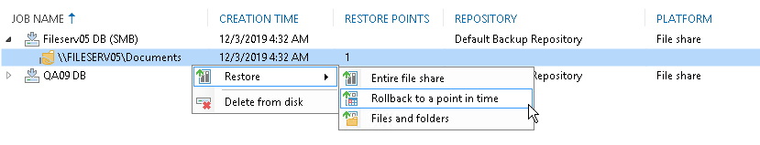
File Share Data의 복구
전체 복구
원래 위치 또는 다른 위치에 복구
특정 시점으로 롤백
특정 복원 시점으로 되돌림
수정되거나 삭제된 파일만 복구
특정 파일 및 폴더
다른 버전의 파일을 복구
원래 위치 또는 다른 위치에 복구
Notes:
#MASTER DECK INFO: Recoveries from the Backup server
#VERSION: 2020/02/20 – Taran Cunningham
#EDITS: <What’s changed>

Slide 35
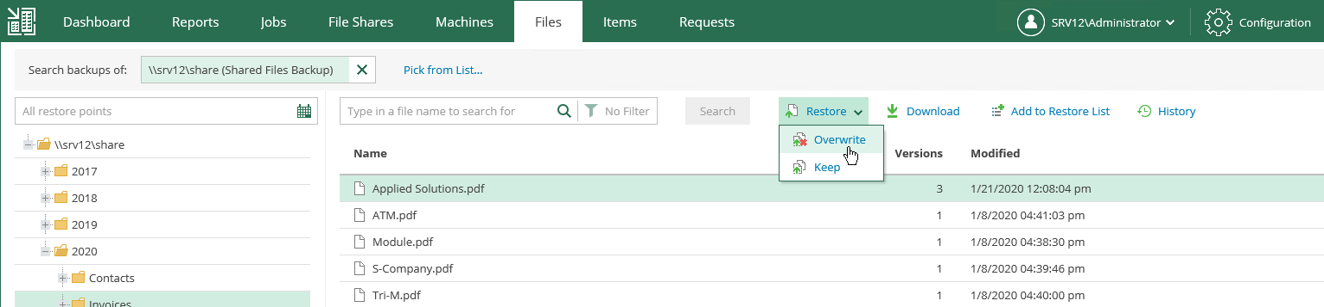
Enterprise Manager
Enterprise Manager의 File Share Backup 항목에서 파일 복구 수행
원래 위치로의 복구
로컬 시스템으로 다운로드
특정 사용자에게 복구 권한 부여(위임)
Notes:
#MASTER DECK INFO: Recoveries from Enterprise Manager
#VERSION: 2020/02/20 – Taran Cunningham
#EDITS: <What’s changed>

Slide 36
NAS 백업 모니터링 – Veeam ONE
Notes:
#MASTER DECK INFO: Veeam One and NAS backup
#VERSION: 2020/02/20 – Taran Cunningham
#EDITS: <What’s changed>

Slide 37
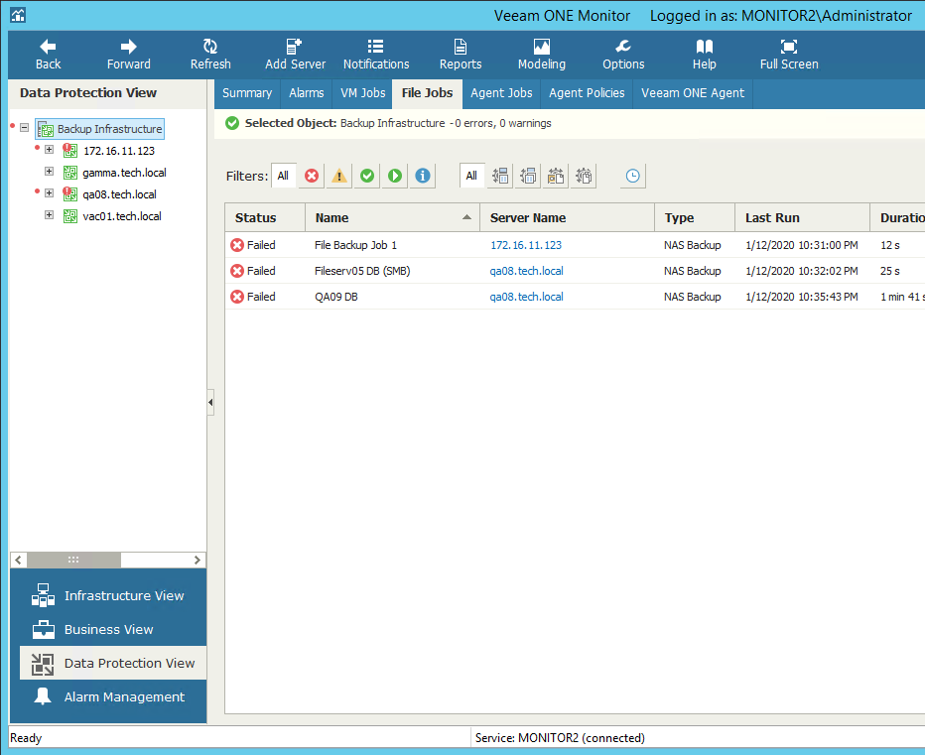
Veeam One
Veeam One Monitor
NAS 백업
NAS 백업 Copy
NAS 백업 job 상태 알림
Veeam One Reporter
Job 히스토리
Notes:
#MASTER DECK INFO: Recoveries from Enterprise Manager
#VERSION: 2020/02/20 – Taran Cunningham
#EDITS: <What’s changed>

Slide 38
NAS Backup Monitoring
File Backup Proxies
# of processed files and sources, data amount
Performance (CPU, Memory usage)
File Shares on Repository
File Backup and Copy Jobs
Real-time job status
Historical job statistics

Slide 39
NAS Backup Alarms
File backup jobs state
File-to-tape jobs state
Proxy connection
Proxy performance

Slide 40
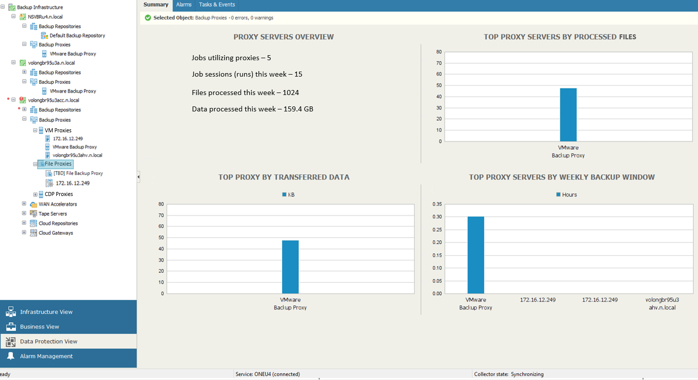
File Proxy

Slide 41
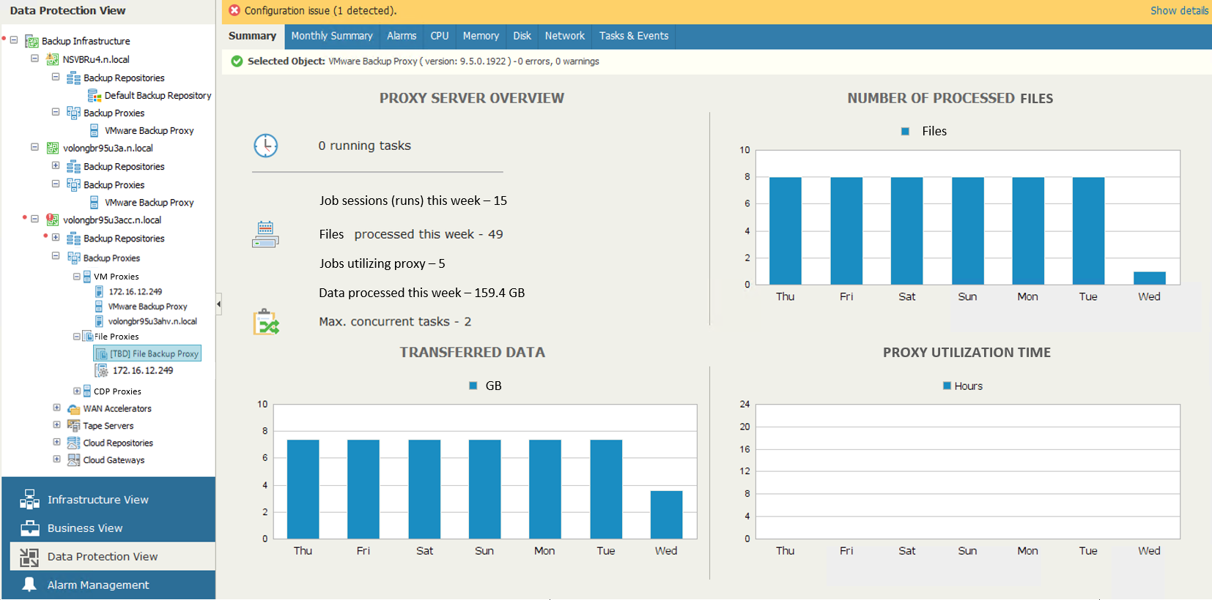
File Proxy

Slide 42
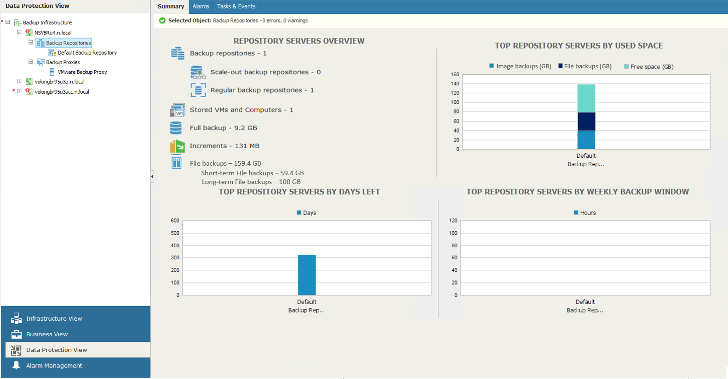
Repository

Slide 43
NAS: Existing Reports Updates
Backup Infr. Audit, Change Tracking
Capacity Planning for Backup Repositories
Backup Alarms Inventory/Overview
Restore Operator Activity
Backup Infrastructure Custom Data

Slide 44
성능 비교
Notes:
#MASTER DECK INFO: Recoveries
#VERSION: 2020/02/20 – Taran Cunningham
#EDITS: <What’s changed>

Slide 45
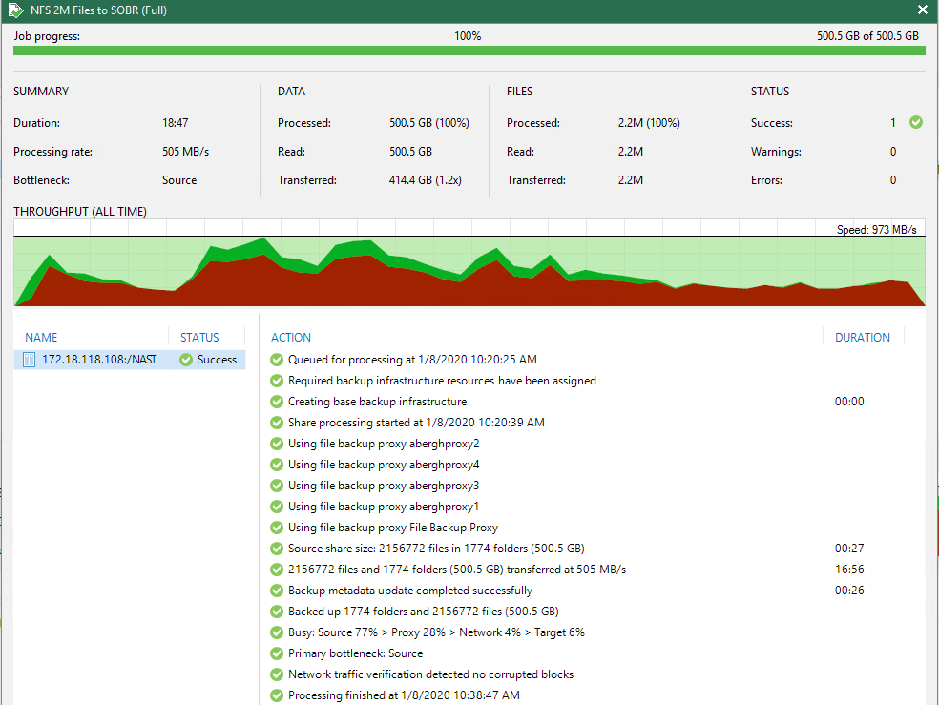
Full Backup Performance Example 2M Files
Highlights:
2백2십만 파일 백업
17 분 전체 백업 완료
973 MB/s 최대치 성능
505 MB/s 평균 성능

Slide 46
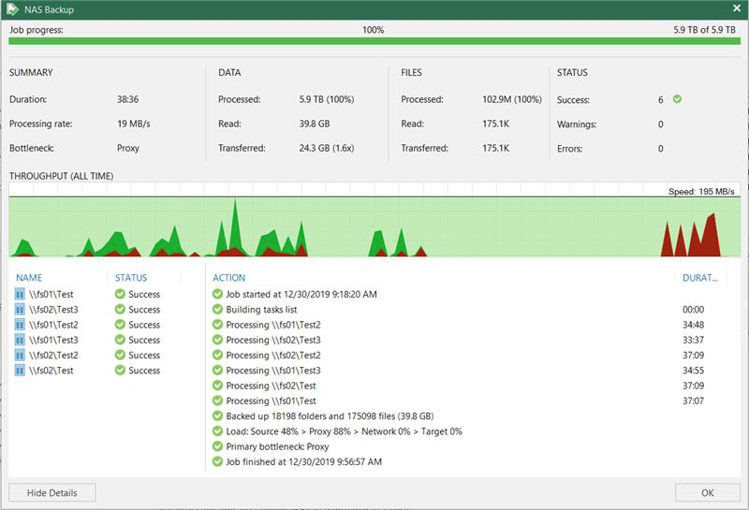
Incremental Performance Example
Highlights :
1억 3백만게 파일 처리
39분 증분 백업 완료
175k 파일 변경 처리
18k 새로운 폴더 처리

Slide 47
NAS PoC 결과(국내)
2억 개 파일 백업 결과 - Full Backup Window : 27~35 Hours
- Incr Backup Window : 1.5~4 Hours
4억 개 파일 백업 결과
- Full Backup Window : 43~59 Hours
- Incr Backup Window : 2~9 Hours
구분 |  |  | Source share size |  |  | Veeam Backup Job |  |  |  | Transferred |  |  | 비고 (파일 생성 방법)
Job Info | Test # | NAS Info | Files | Folders | Size | Duration | Process | Transfer | Metadata update | Files | Folders | Size
200 Million Files Single Proxy 10 Session | 200M-10S_SP-1F | inode 198,091,975 835GB | 198,140,152 | 110 | 378 GB | 27:43:10 | 1:20:50 | 26:33:17 | 1:09:25 | 198,140,152 | 110 | 378 GB | 2K 파일로 생성, 폴더 data1~data10 폴더별 2,000만개(하위에 200만개 10개 폴더)
 | 200M-10S_SP-1I | inode 199,196,692 891GB | 199,194,453 | 133 | 379 GB | 2:35:30 | 2:15:39 | 2:33:36 | 0:01:31 | 1,005,271 | 28 | 986.9 MB | 1K파일 약 100만개 추가 생성 z:\data9\new, z:\data10\new에 5만개 파일 폴더 10개씩 생성
 | 200M-10S_SP-2I | inode 199,195,377 895GB | 199,195,377 | 133 | 379 GB | 4:00:18 | 2:14:40 | 3:59:37 | 0:00:16 | 924 | 93 | 1.8 MB | 2K파일 10개를 모든 폴더에 생성 : 총 1,000개 파일 추가
200 Million Files Single Proxy 1 Session | 200M-1S_SP-1F | inode 199,195,377 895GB | 199,195,387 | 134 | 379 GB | 35:08:38 | 1:23:18 | 33:55:58 | 1:12:05 | 199,195,387 | 134 | 379 GB | 위의 10개 Session 3nd 백업과 동일 데이터를 새로운 Job을 생성하여 Full 백업
 | 200M-1S_SP-1I | inode 200,197,649 945GB | 200,195,387 | 156 | 380 GB | 1:27:07 | 1:23:24 | 1:26:14 | 0:00:28 | 1,000,000 | 24 | 976.6 MB | 1K파일 약 100만개 추가 생성 z:\data9\new2, z:\data10\new2에 5만개 파일 폴더 10개씩 생성
 | 200M-1S_SP-2I | Inode 200,198,650 935GB | 200,196,387 | 156 | 380 GB | 2:26:11 | 1:10:00 | 2:25:00 | 0:00:18 | 924 | 93 | 1.8 MB | 2K파일 10개를 모든 폴더에 생성 : 총 1,000개 파일 추가
400 Million Files Multi Proxy 20 Session (Non-SSD Cashe) | 400M-20S_MP-1F | inode 400,001,712 1789GB | 399,997,304 | 296 | 658 GB | 43:10:02 | 1:42:29 | 40:42:58 | 2:26:22 | 399,997,304 | 296 | 658.1 GB | 1,2K 파일로 생성, 폴더 data1~data20 폴더별 2,000만개(하위에 200만개 10개 폴더)
 | 400M-20S_MP-1I | inode 400,021,746 1733GB | 400,017,336 | 296 | 658.1 GB | 2:53:49 | 2:51:12 | 2:53:05 | 0:00:08 | 20,032 | 1 | 19.6 MB | 1K파일 약 2만개(z:\data7\data1_11\) 추가 생성
 | 400M-20S_SP-2I | Inode 400,241,748 1679GB | 400,237,336 | 298 | 658.3 GB | 5:02:18 | 4:21:52 | 4:51:14 | 0:10:24 | 220,000 | 20 | 214.8 MB | 1K파일 1만개를 22개의 폴더에 각각 추가 생성 : 총 22만개 파일 추가 (200M-1S_SP-2I 백업 후 수행) Single Proxy로 백업
 | 400M-20S_SP-3I | Inode 400,241,748 1679GB | 400,237,336 | 298 | 658.3 GB | 8:11:54 | 4:06:47 | 7:16:17 | 0:55:07 | 20,824,330 | 12 | 39.1 GB | data1폴더를(약 2천만개) data21로 이름 변경 후 Job에서 data1을 data21로 변경 후 Incr 백업
 | 400M-20S_SP-4I_SSD | Inode 400,241,748 1679GB | 400,237,336 | 298 | 658.3 GB | 9:11:17 | 2:25:42 | 8:08:19 | 1:02:04 | 20,824,330 | 12 | 39.1 GB | data21폴더를(약 2천만개) data22로 이름 변경 후 Incr 백업 (SSD Cashe 이용)
 | 400M-20S_MP-5I | inode 400,243,749 1667GB | 400,239,336 | 296 | 658.3 GB | 6:37:15 | 1:52:08 | 6:36:05 | 0:00:36 | 2,000 | 200 | 2 MB | 1K파일 10개를 모든 폴더에 생성 : 총 2,000개 파일 추가 (Multi Proxy 이용한 백업)
 | 400M-20S_SP-6I | inode 400,245,750 1667GB | 400,241,336 | 296 | 658.3 GB | 6:04:59 | 2:55:14 | 6:03:54 | 0:00:32 | 2,000 | 200 | 2 MB | 1K파일 10개를 모든 폴더에 생성 : 총 2,000개 파일 추가 (Single Proxy 이용한 백업)
400 Million Files Single Proxy 1 Session | 400M-1S_SP-1F | inode 400,021,746 1733GB | 400,017,336 | 298 | 658.1 GB | 59:30:39 | 2:12:27 | 56:38:09 | 2:52:15 | 400,017,336 | 298 | 658.1 GB | 위의 20개 Session 2nd 백업과 동일 데이터를 새로운 Job을 생성하여 Full 백업
 | 400M-1S_SP-1I | inode 400,041,746 1736GB | 400,037,336 | 298 | 658.1 GB | 4:54:09 | 4:32:17 | 4:53:50 | 0:00:07 | 20,000 | 1 | 19.5 MB | 1K파일 약 2만개(z:\data8\data1_11\) 추가 생성
 | 400M-1S_SP-2I | Inode 400,241,748 1692GB | 400,237,336 | 298 | 658.3 GB | 4:36:24 | 3:44:48 | 4:23:05 | 0:12:49 | 200,000 | 20 | 195.3 MB | 1K파일 1만개를 20개의 폴더에 추가 생성 : 총 20만개 파일 추가
 | 400M-1S_SP-3I_SSD | Inode 400,241,748 1679GB | 400,237,336 | 298 | 658.3 GB | 6:32:43 | 2:46:01 | 5:36:16 | 0:56:12 | 20,824,330 | 12 | 39.1 GB | data1폴더를(약 2천만개) data21로 이름 변경 후 Incr 백업
 | 400M-1S_SP-4I | Inode 400,241,748 1692GB | 400,237,336 | 298 | 658.3 GB | 7:06:26 | 2:31:19 | 6:09:28 | 0:56:04 | 20,824,330 | 12 | 39.1 GB | data1폴더를(약 2천만개) data22로 이름 변경 후 Incr 백업 (SSD Cashe 이용)
 | 400M-1S_SP-5I | Inode 400,243,749 1670GB | 400,239,336 | 298 | 658.3 GB | 8:23:35 | 2:40:39 | 8:22:31 | 0:00:31 | 2,000 | 200 | 2 MB | 1K파일 10개를 모든 폴더에 생성 : 총 2,000개 파일 추가

Slide 48
NAS PoC 결과(국내-타사)
5천만 개 파일 백업 결과 - Full Backup Window : 41 Hours
- Incr Backup Window : 18 Hours
2억 개 파일 백업 예상 결과
- Full Backup Window : 150 Hours
- Incr Backup Window : 72 Hours
순서 | 구분 | 소구분 | 소스 데이터 정보 |  |  | 백업 정보
 |  |  | 백업 볼륨명 | 볼륨 용량 | 파일 개수 | 수행 시간 | Scan 수행 시간 | 데이터 전송 시간 | Total 소요 시간 | 백업 용량 | 저장 용량 | Saving(%) | 시간 당 성능 | 초 당 성능
1 | NAS 백업 (NFS) | FULL 백업 (초기 백업) | /file2100 | 6.2TB | 2,148만개 | 10/31 16:00 | 14시간 29분 | 26시간 51분 | 41시간 20분 | 6.2TB | 1.75TB | 71% | 273GB/h | 78MB/sec
 |  |  | /file1300 | 3.8TB | 921만개 |  | 05시간 06분 | 13시간 44분 | 18시간 50분 | 3.8TB | 858GB | 77% | 272GB/h | 77MB/sec
 |  |  | /file850 | 5.8TB | 1,251만개 |  | 06시간 57분 | 25시간 24분 | 32시간 21분 | 5.8TB | 3.3TB | 42% | 238GB/h | 68MB/sec
 |  |  | /file740 | 3.8TB | 743만개 |  | 03시간 29분 | 12시간 13분 | 15시간 42분 | 3.8TB | 809GB | 78% | 315GB/h | 90MB/sec
2 | NAS 백업 (NFS) | Incre 백업 (순서2번 기준) | /file2100 | 6.8TB | 2,148만개 | 11/02 19:00 | 12시간 20분 | 06시간 03분 | 18시간 23분 | 1.39TB | 509GB | 64% | 235GB/h | 67MB/sec
 |  |  | /file1300 | 3.8TB | 921만개 | 11/02 21:00 | 04시간 30분 | 06분 | 4시간 36분 | 8.5GB | 3.46GB | 59% | 78GB/h | 22MB/sec
 |  |  | /file850 | 6.8TB | 1,253만개 |  | 06시간 41분 | 12시간 16분 | 18시간 57분 | 3.16TB | 692GB | 78% | 263GB/h | 75MB/sec
 |  |  | /file740 | 3.8TB | 743만개 |  | 03시간 23분 | 03분 | 3시간 26분 | 2.99GB | 2.26GB | 24% | 57GB/h | 16MB/sec
3 | NAS 백업 (NFS) | Incre 백업 (순서3번 기준) | /file2100 | 7.6TB | 2,148만개 | 11/04 19:00 | 11시간 49분 | 06시간 13분 | 18시간 02분 | 1.58TB | 960GB | 40% | 260GB/h | 74MB/sec
 |  |  | /file1300 | 3.5TB | 921만개 |  | 04시간 30분 | 02분 | 4시간 32분 | 2.08GB | 516MB | 75% | 43GB/h | 12MB/sec
 |  |  | /file850 | 6.4TB | 1,253만개 |  | 06시간 07분 | 11시간 06분 | 17시간 13분 | 2.59TB | 196.3GB | 92% | 238GB/h | 68MB/sec
 |  |  | /file740 | 3.8TB | 743만개 |  | 03시간 38분 | 20분 | 3시간 58분 | 103GB | 3.61GB | 96% | 299GB/h | 85MB/sec
4 | NAS 백업 (NFS) | Incre 백업 (순서4번 기준) | /file2100 | 7.9TB | 2,178만개 | 11/06 13:00 | 12시간 40분 | 4시간 15분 | 16시간 55분 | 1.06TB | 45.51GB | 95% | 256GB/h | 73MB/sec
 |  |  | /file1300 | 3.5TB | 923만개 |  | 05시간 23분 | 03분 | 5시간 26분 | 2.99GB | 505M | 83% | 55GB/h | 16MB/sec
 |  |  | /file850 | 6.5TB | 1,324만개 |  | 06시간 42분 | 7시간 41분 | 14시간 23분 | 1.96TB | 125.41GB | 93% | 262GB/h | 75MB/sec
 |  |  | /file740 | 3.9TB | 743만개 |  | 04시간 07분 | 07분 | 4시간 14분 | 58.3GB | 8.86GB | 84% | 489G/h | 139MB/sec

Slide 49
감사합니다.

